Slide 1
Subject: Electricity Laboratory
Experiement 3: The ratio between lamp power
Al-Karkh University of Science
College of Science
Department of Medical Physics
Prepared by:
Dr. Nihad K Ali
Zaineb Faleh Nazal

Slide 2
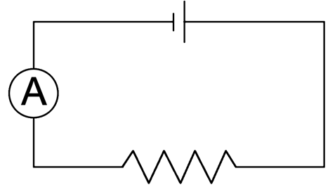
A graphical method for calculating ammeter resistance
Theory:
If you have a circuit as below:
R.B
Figure (1). Practical experiment circuit.

Slide 3
Objective of the experiment:
Calculating ammeter resistance.
Study the properties of series circuit.

Slide 4
Instruments:
DC power supply.
Ammeter.
Resistors box.
Connection wires.

Slide 5
Instruments:
DC power supply.
Lamp.
Voltmeter.
Ammeter.
Resistors box.
Connection wires.

Slide 6
Methods:
Connect the circuit as shown in Figure 1.
Set a resistance value from resistance box, then record the current value from the ammeter.
Gradually reduce the resistance value from resistor box and record the current increasing from ammeter.
Organize a table for R and I as shown below:

Slide 7
No. | R.B (Ω) | I (A) | 1/I (A⁻¹)
1
2
3
4
5
6
7

Slide 8
Calculate the current inverse.
Draw a graph for the resistance value R and current inverse as shown in Figure 2.
Find from the graph the ammeter resistance R_{A}.
Discussion:
Q1) list the most error source in the experiment?
Q2) What is the ammeter operation principal? The idea of it?
Q3) Why the ammeter is always connected in series? What happen if it connected in parallel?

